Slide 1
Transcriptomics Atlas Pipeline: Cloud vs HPC
Piotr Kica, Sabina Lichołai, Maciej Malawski

Slide 2
Transcriptomics Atlas Pipeline
Pipeline description
Goal: Create public Atlas/dataset containing many human tissues (e.g. nervous/kidney cells) by processing public .sra files from NCBI)
Implemented path: Salmon Pipeline
Tools: SRA-Toolkit, Salmon, DESeq2
Future path: STAR pipeline

Slide 3
Transcriptomics Atlas Pipeline
Cloud Architecture
Monitoring using CloudWatch Agent
Easy to scale architecture
AWS cloud, EC2 as the main compute service

Slide 4
Transcriptomics Atlas Pipeline
HPC deployment
Apptainer containers
With SRA-Toolkit, Salmon with generated index, R with DESeq2, pipeline code
Ares Cluster at ACK Cyfronet AGH
Reusing AWS services (S3, SQS) but HPC as the main compute

Slide 5
Transcriptomics Atlas Pipeline
Pipeline resource usage and HPC vs Cloud comparision
99 processed .sra files
HPC and Cloud
2vCPU, 8GB RAM (EC2 instance/ HPC-job)
Performance comparison between Cloud and HPC. Calculated as an average of relative difference in execution time.
Aggregated "instance-wide" metrics during execution of each pipeline step. Baseline memory is approx. 300MB.

Slide 6
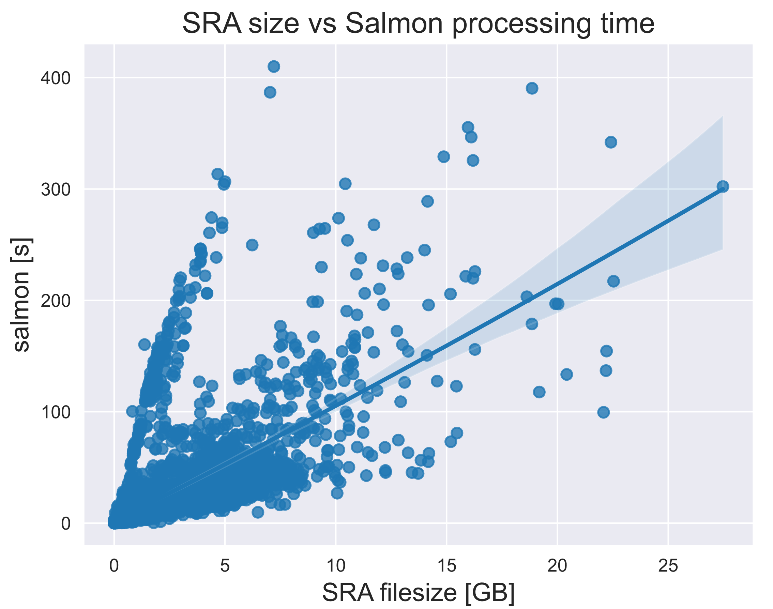
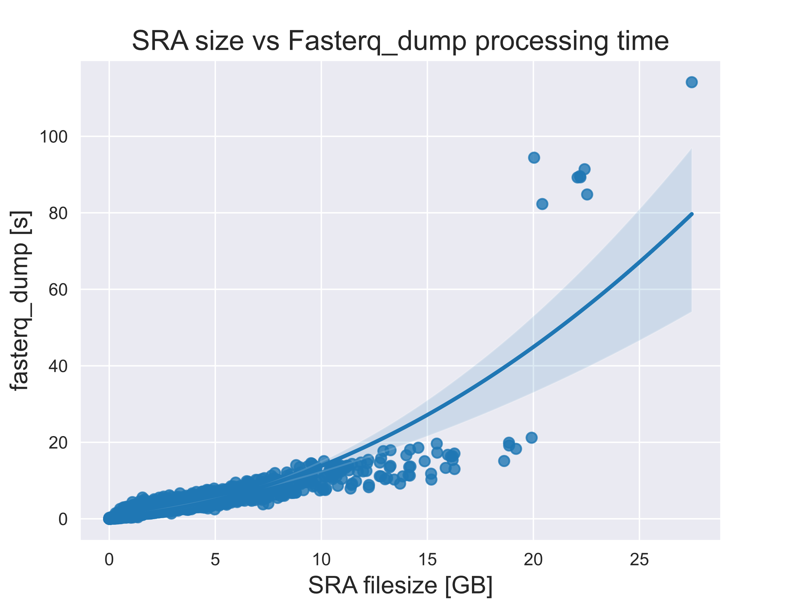
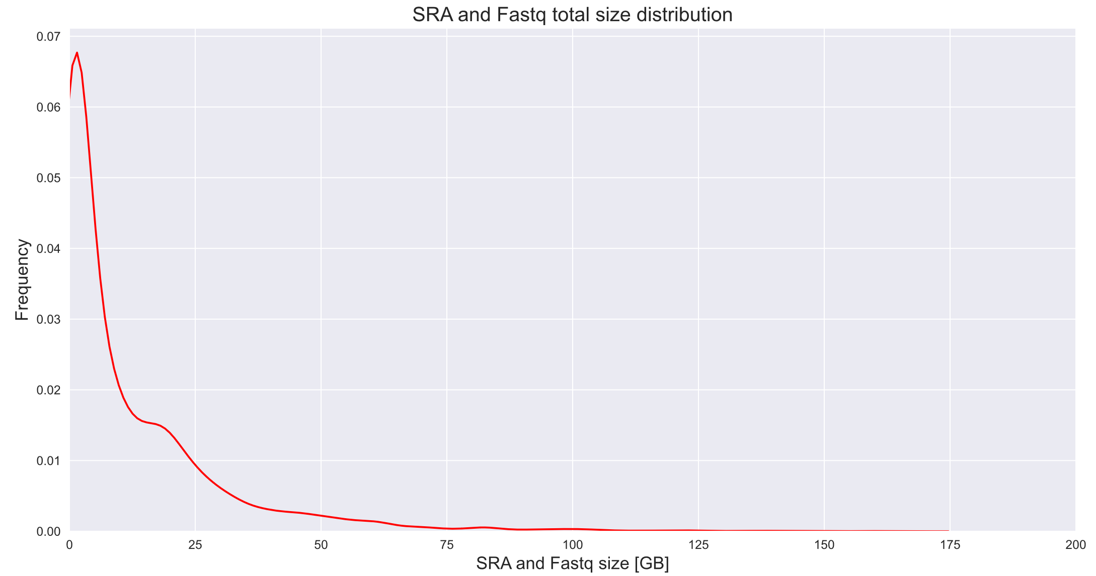
Transcriptomics Atlas Pipeline
Newest results
Processed of 10 TB of .sra data (>8000 files)
with metadata to analyze
Atlas for 19 tissues (using Salmon Pipeline)

Slide 7
Transcriptomics Atlas Pipeline
Conclusions
Developed and used Salmon Pipeline for Transcriptomics Atlas
HPC and Cloud compatible deployment
Measured Salmon Pipeline performance in EC2 environment
Implement STAR Pipeline and process the same files
Measure STAR performance on EC2
Compare STAR on EC2 and HPC
Create On-Demand publicly available solution for the Pipelines with tissue name->.sra files search service
Future work

Slide 8
This publication is supported by the European Union’s Horizon 2020 research and innovation programme under grant agreement Sano No 857533 and is supported by Sano project carried out within the International Research Agendas programme of the Foundation for Polish Science, co-financed by the European Union under the European Regional Development Fund. This publication is also partly supported by the European Union’s Horizon Europe research and innovation programme under grant agreement NEARDATA No 101092644. This research was supported in part by PLGrid Infrastructure. Computations have been performed at Ares supercomputer at ACC Cyfronet AGH.
Maciej Malawski
Director @ Sano
Research Team Leader of Extreme-scale Data and Computing
e: m.malawski@sanoscience.org
Piotr Kica
Junior Scientific Programmer @ Sano
e: p.kica@sanoscience.org

